Slide 1
Deep learning for time-series
Assignment 3

Slide 2
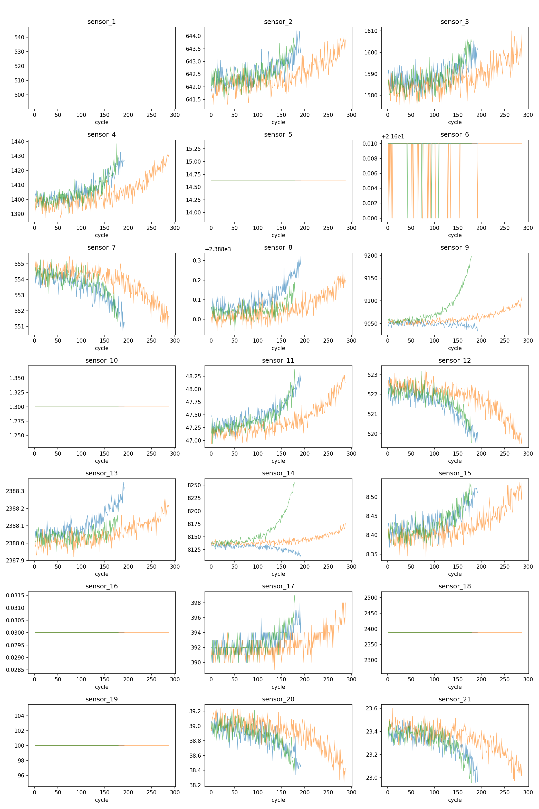
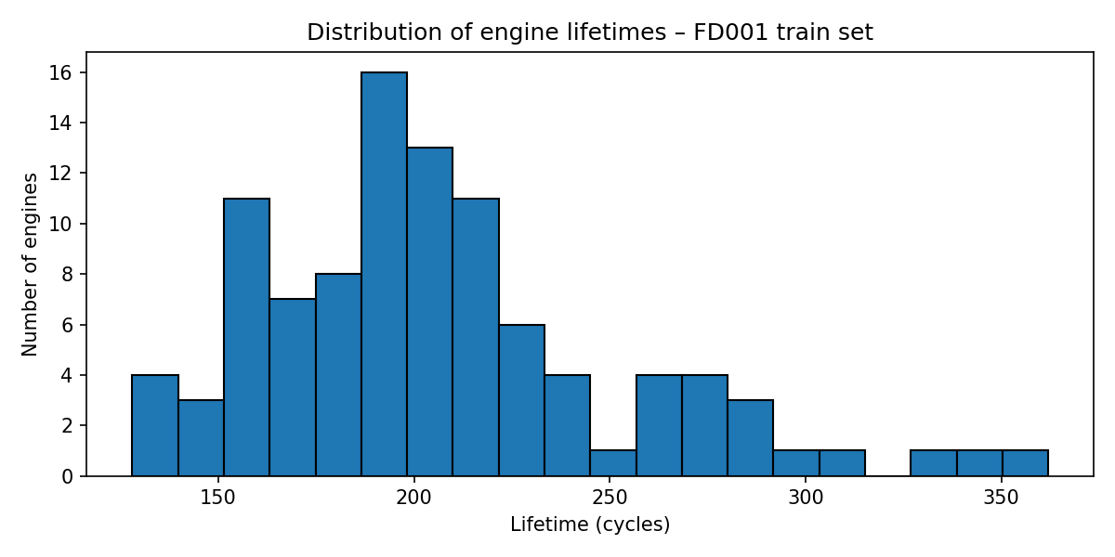
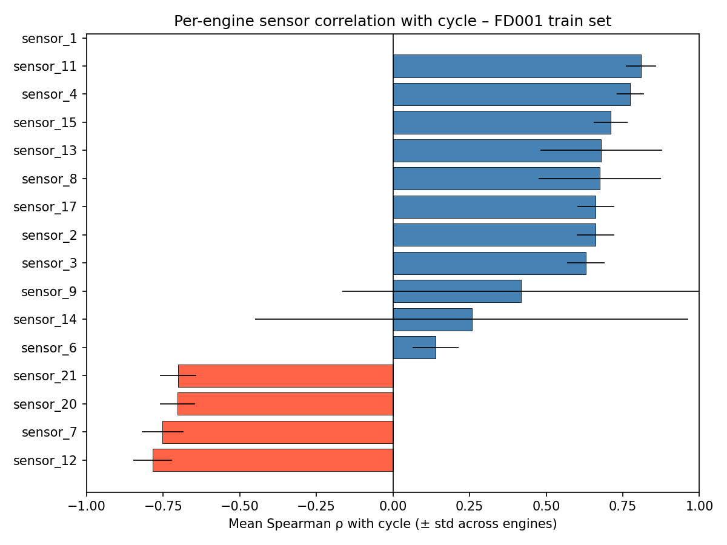
EDA – FD001
Multiple sensor trajectories have clear (noisy) monotonic relationship with remaining cycles
The ending sensor values are comparable for multiple sensors
Some sensors are clearly not informative
Only few sensors show different behaviours accross engines
Spearman > 0.5, std < 0.3

Slide 3
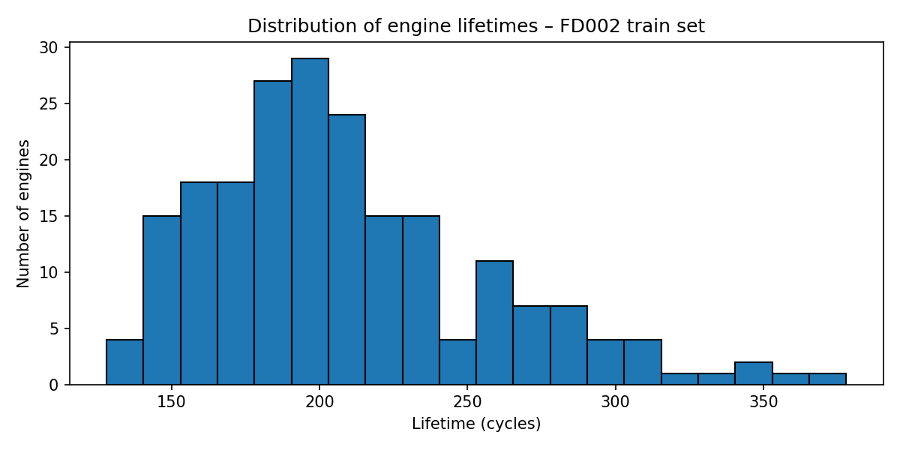
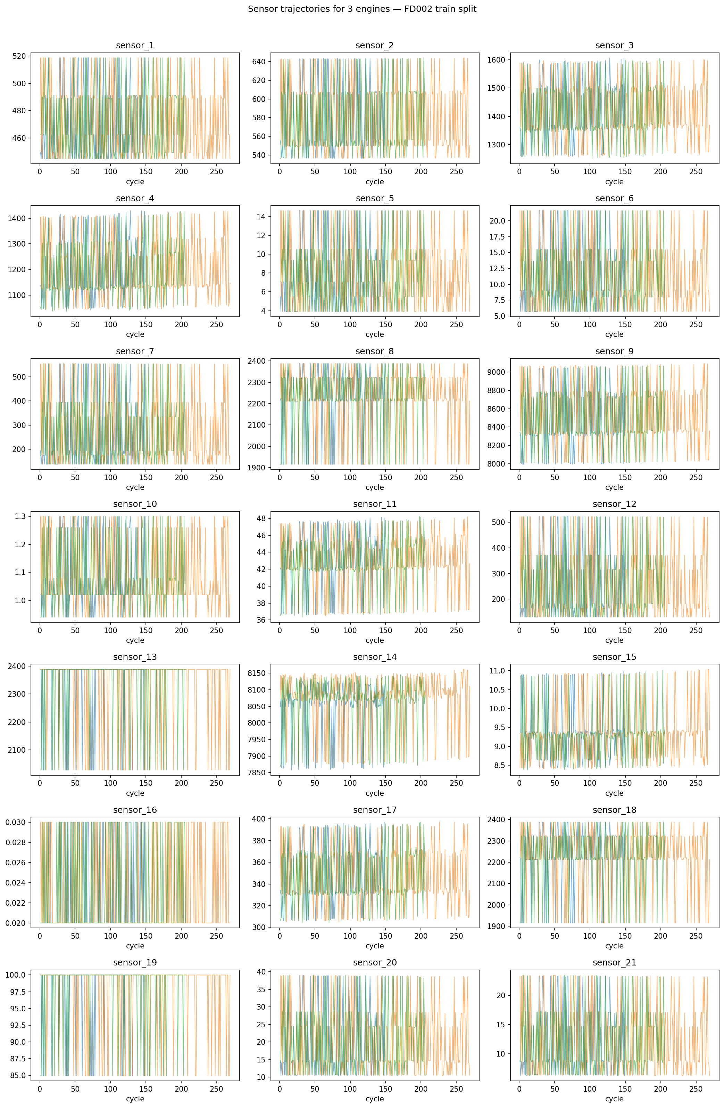
EDA – FD002
Approximately same distribution of lifetimes as for FD001
Sensor data is meaningless without clustering

Slide 4
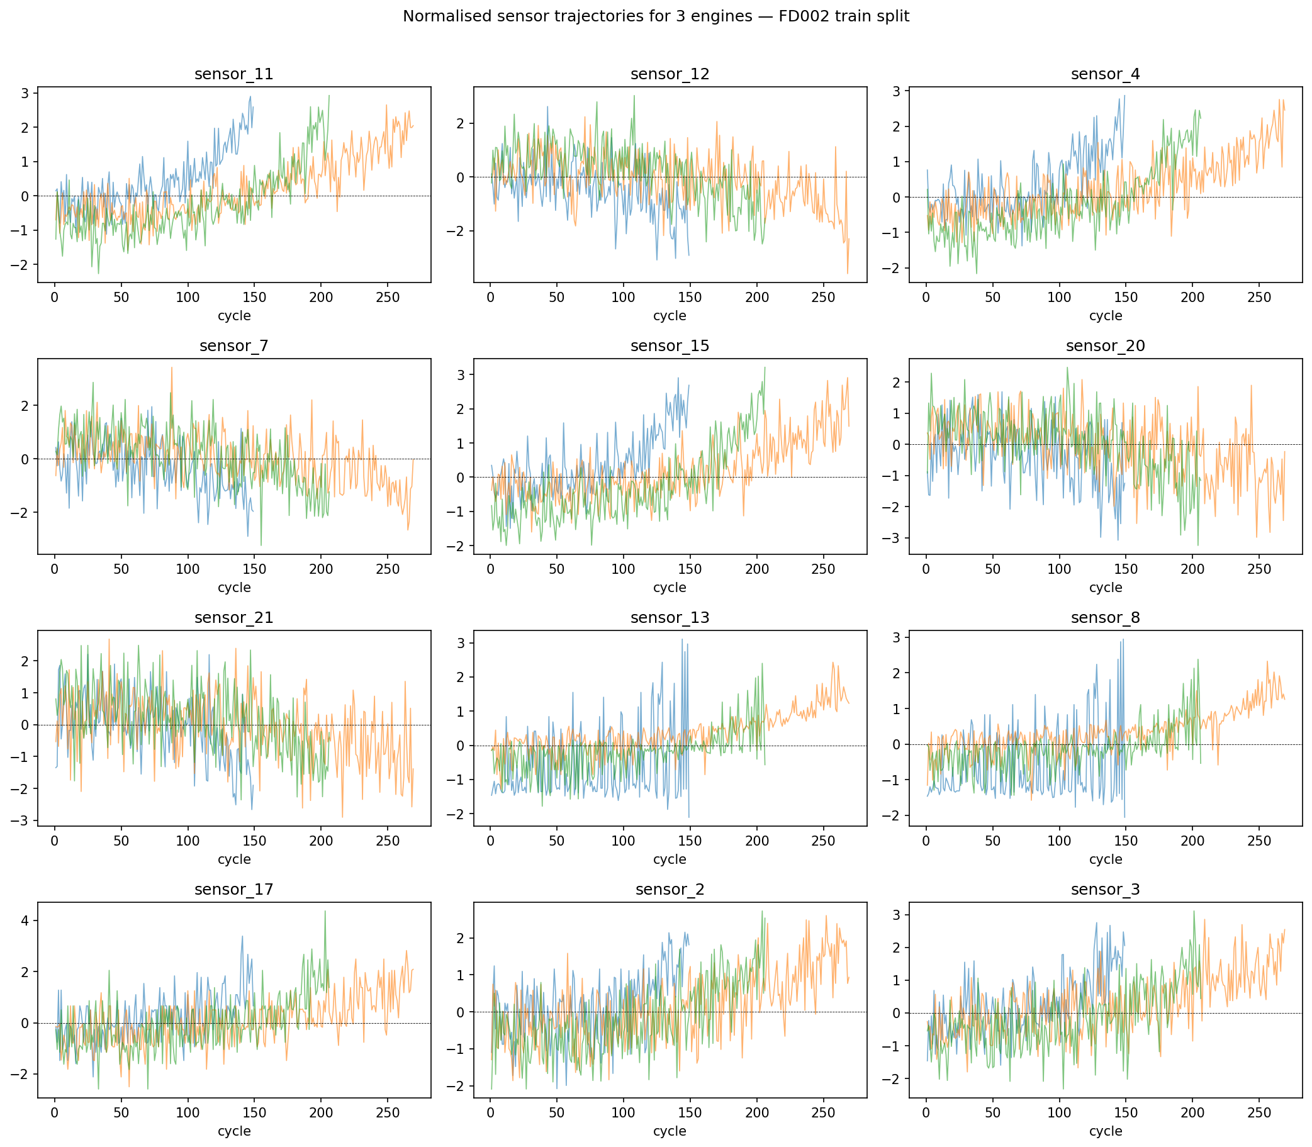
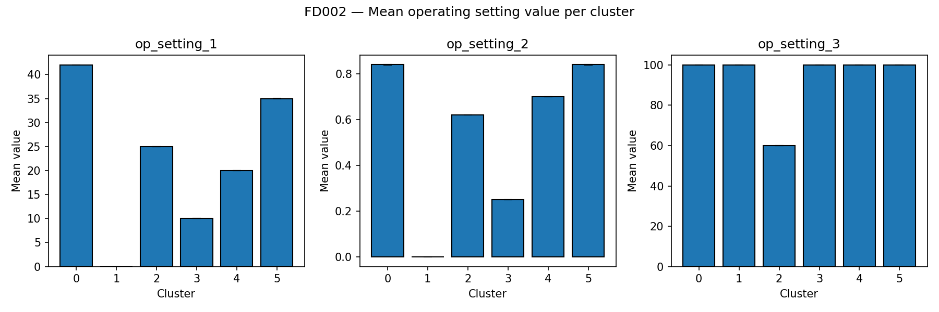
Data preparation
FD001
RUL label construction: constructed as piecewise-linear with a cap of 125 cycles
Train/validation split: A classic 80/20 split by engines for train/val is used
Normalization: The sensor values are Z-score normalized across engines
Fixed random seed: A fixed random seed (42) is used for train/val split
FD002
K-means clutering on operating settings
Normalisation across engines inside each cluster

Slide 5
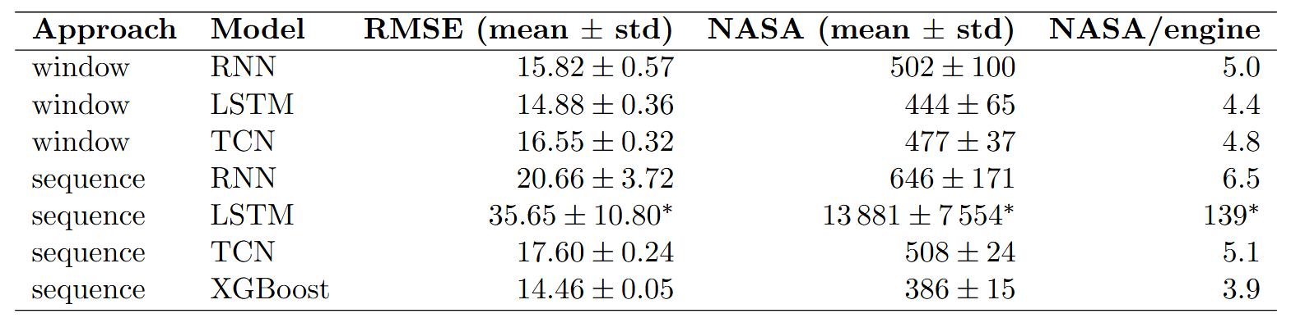
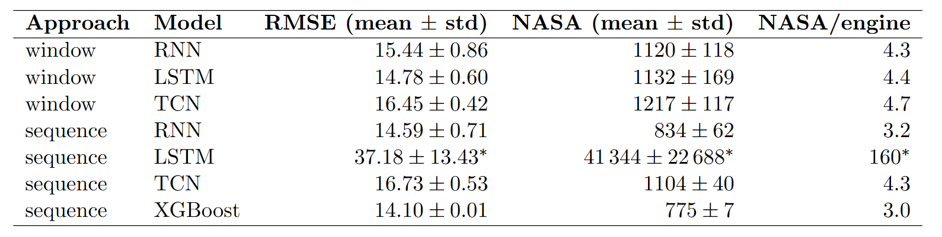
1.2 – Standard model configurations
FD001
FD002

Slide 6
3.2 – Focused hyperparameter study
Architecture: LSTM
Window size w ∈ {20, 30, 50} — controls the temporal context available to the model per prediction
Hidden size h ∈ {64, 128} — controls model capacity
Learning rate η ∈ {10−4, 10−3} — controls optimization step size

Slide 7
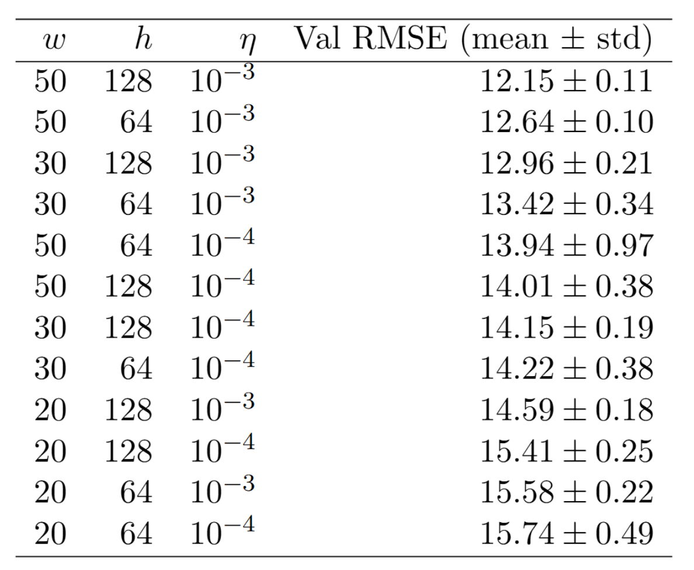
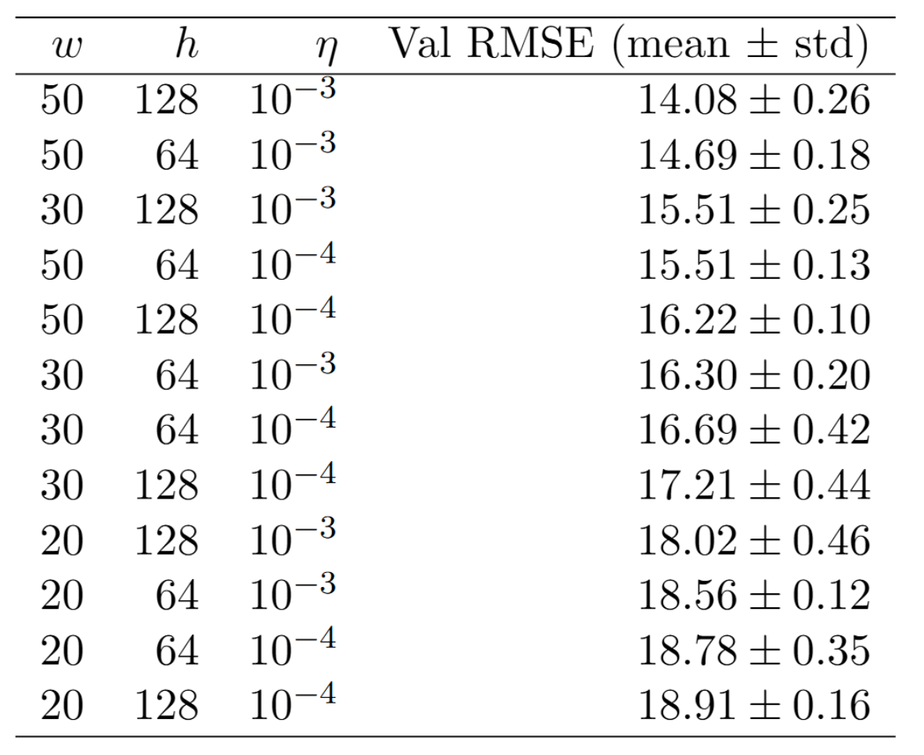
3.2 – Focused hyperparameter study: Window approach
FD001
FD002

Slide 8
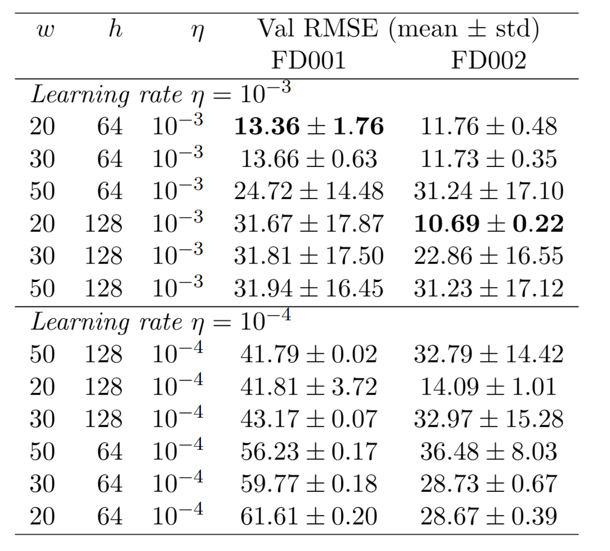
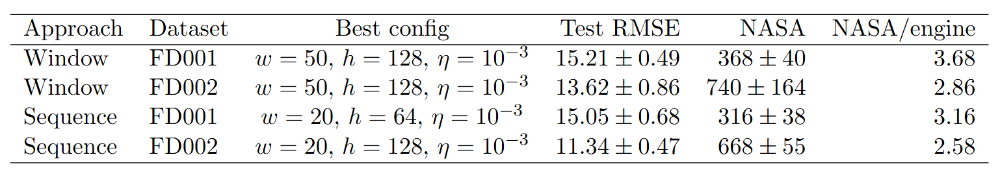
3.2 – Focused hyperparameter study: Sequence approach
Shorter windows converge more easily and reach better RMSE
Models train VERY slowly
Eta = 0.0001 collapses and/or does not converge quickly enough
Best models are as good or better in RMSE and NASA as XGBoost
Best models are slower and harder to train and more unstable than XGBoost
Best hyperparameters are at the edge of the grid – larger study needed

Slide 9
Comparative analyses
Within raw window
LSTM best in mean
Within sequence
TCN: low variance, consistent convergence
RNN: worse than TCN and more unstable
LSTM: highly unstable, sensitive to hypeparameters, maybe forget gate collapse?
Tuned XGBoost best
Between approach
RNN: windowed best on FD001, sequence on FD002 – more training?
TCN: Similar. Does not see whole sequence history.
LSTM: Unstable for both sequence cases
Tuned XGBoost still best
Deep learning vs. XGBoost
Tuned Xgboost wins in the beginning
Tuned LSTM approaches on FD001 and wins on FD002
A single window of features captures a lot of information
Hyperparameters are very important and more can be gained
FD001 vs. FD002
No big changes in RMSE or NASES – suggests that per-cluster-and-sensor normalization works
RMSE vs. NASA
Agree in most cases. The LSTM collapses inflate the scores

